Slide 1
LOAN APPROVAL INSIGHTS
P03EH23M015069 ANKITA ROY

Slide 2
PROBLEM STATEMENT
Visualizing Financial Risk and Decision-Making
In the financial sector, ensuring effective loan approval processes requires a thorough analysis of applicant profiles, credit risk factors, and financial metrics. Manual evaluation of loan approval data is often time-consuming and lacks actionable insights to support strategic decision-making.

Slide 3
DATA REQUIREMENT
Data is collected from across various banks from the loan department.

Slide 4
DATA COLLECTION
Through market research data is collected

Slide 5
DATA VALIDATION
Data Completeness: Verify that all entries contain values for each nutritional category.
Data Consistency: Ensure values fall within plausible ranges, e.g., fat values for individual items should generally be less than 100 grams.
Data Cleanliness: Remove any unnecessary columns

Slide 6
DATA PROCESSING
Data Cleaning: Drop unnecessary columns and standardize missing values.
Data Transformation: Normalize or scale nutritional values for easier comparisons, create new metrics if needed
Feature Engineering: Calculate additional metrics
Analysis Preparation

Slide 7
TOOLS
Analytical tool Tableau is used for the visualiation purpose

Slide 8
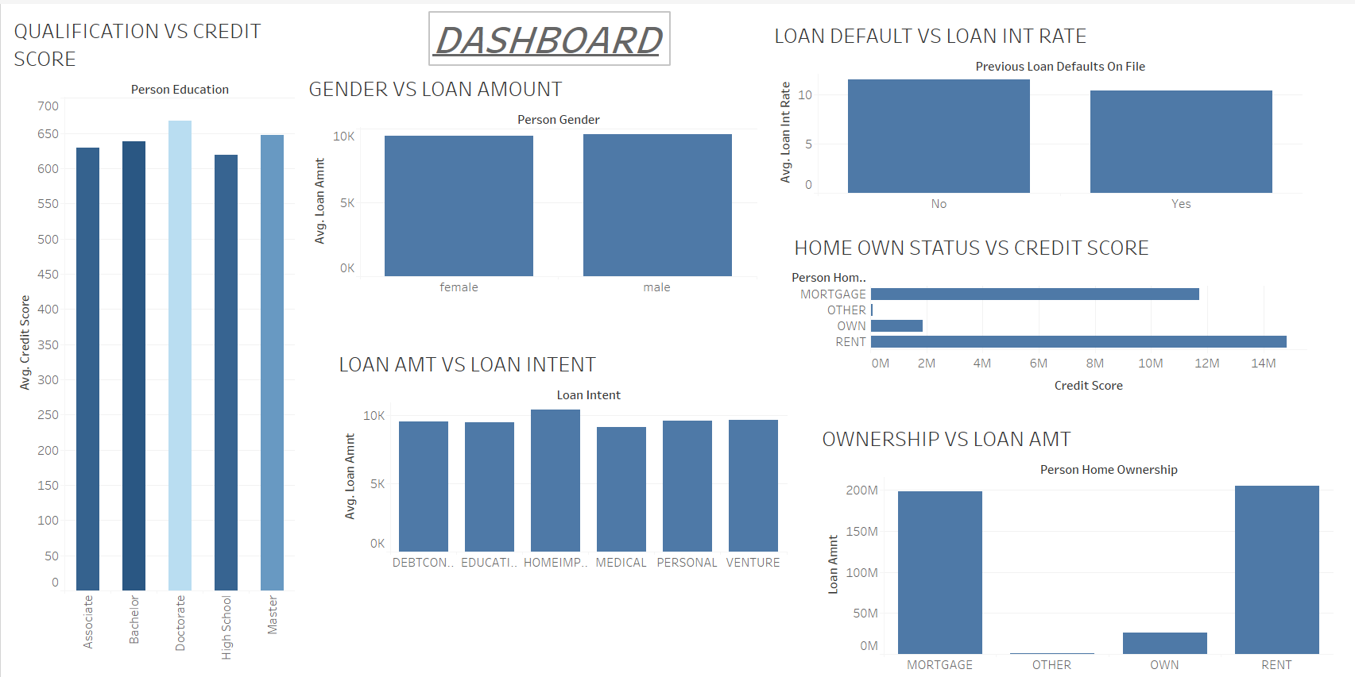

Slide 9
INFERENCES
1. Person with highest qualification DOCTORATE has highest credit score
2. Male gender took more loans compared to female
3. According to the dataset provided, person with loan defaulter has less loan interest
4.Person staying in rent has maximum credit score
5. Home improvement is the maximum purpose of loan applications
6. Person who has mortgage has taken maximum loan amount

Slide 10
THANK YOU

